Slide 1
Building a Redux Appliction
With Daniel “The Code Whisperer” Stern github.com/danielstern @danieljackstern

Slide 2

Goals n’ Such
Build a basic Redux application from scratch
Use createStore to… create a store
Build a reducer that’s not trivial
Practice two main ways of updating arrays
Write code to render application whenever state changes
.

Slide 3

Our Application: Music Lover’s Compendium
Create a list of all your favorite songs!
Add new songs to the list
Adjust each song’s personal rating
Each song can be rated from
1 (worse than Pizza Underground) to
5 (Somewhere between Metallica and Slayer)
The application automatically orders the songs based on their score
Redux manages the state!

Slide 4
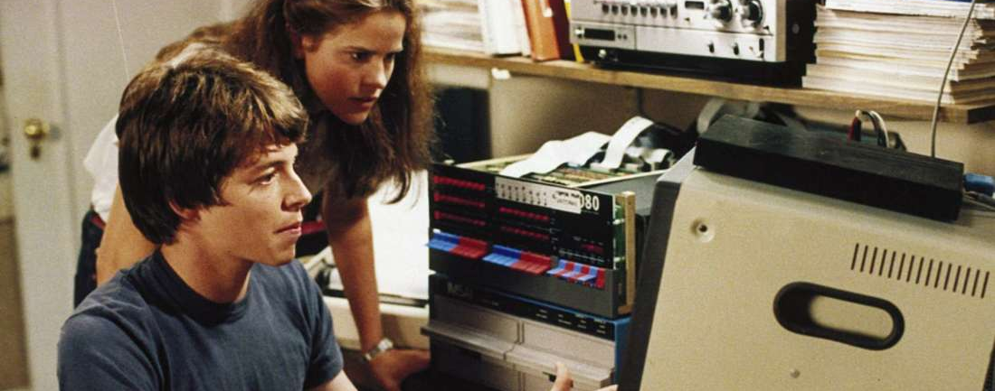

It’s coding time!
Fasten your seatbelts!
Open your text editor!
Source code at: https://github.com/danielstern/ranked-todoMVC

